Slide 1
Project #2 Proposal Group 11: Jagan Dwarampudi, Mohammad Shameer
CIS6930 Human-Centered Input Recognition Algorithms Instructor: Dr. Lisa Anthony, Spring 2023
March 28, 2023

Slide 2
WHAT to extend?
Project #1:
Algorithm: $1
Language: Python
Existing dataset*: $1 Unistroke gestures [10 people]
New dataset: $1 Unistroke gestures [6 people]
Analysis: user-dependent recog. accuracy and GHOST heatmaps
Project #2:
Algorithm: $1 (Protractor)
Language: Python
Existing dataset*: $1 Unistroke gestures [10+6 people]
New dataset*: n/a
Analysis: Recognition accuracy comparison for both algorithms and among datasets.

Slide 3
WHY is it interesting?
Protractor algorithm has a separate paper.
It presents evaluation metrics over the 10-user dataset in comparison to GSS.
It claims an improvement of over 6x speed.
Test reproducibility over new dataset from Project 1

Slide 4
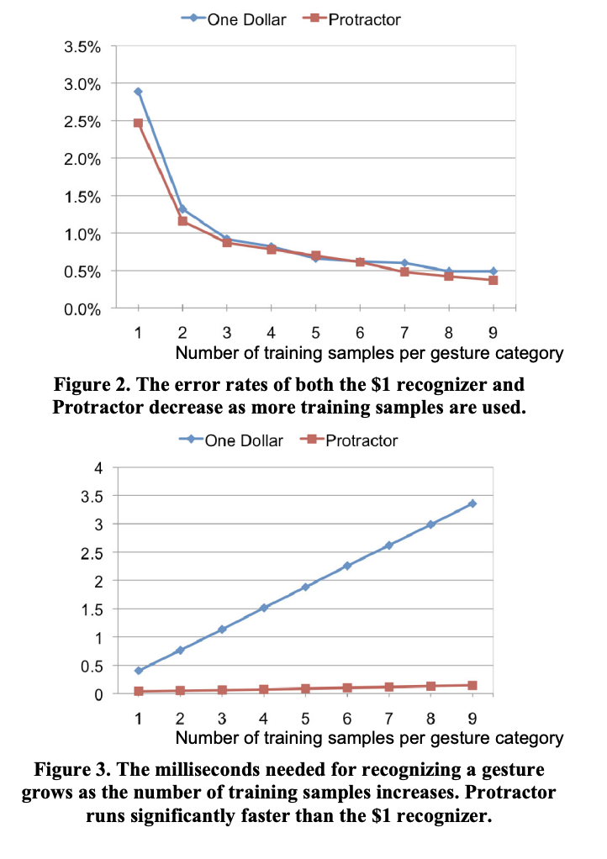
Expected OUTCOME?
Our implementation is a replication of the published algorithm.
Hence, it is expected to show similar results for the 10-user dataset.
The results for 6-user new dataset must also be closer to results for 10-user dataset.

Slide 5
The End!

